Slide 1


Department of Computer Science and Engineering
TESLA STOCK PRICE PREDICTION USING REGRESSION MODEL
ARUNA K (211419104020)
ASTALAKSHMI G (211419104028)
PREETHI B (211419104200)
Guide
Co-ordinator
Dr.K.Sangeetha M.E,Ph.D.,
Dr.Kavitha Subramani M.E,Ph.D.,

Slide 2
Abstract
Stock prices are initially set by an initial public offering (IPO), which occurs when a company first issues its shares on the market. Investment companies use a variety of metrics, including the total number of shares being offered, to calculate the price of a stock. The share price will then fluctuate as a result of the factors mentioned, with potential business earnings having a substantial impact. Using financial metrics including a company's earnings history, market movements, and the profit it is predicted to make, traders regularly evaluate a company's value. As a result, stock price forecasting has grown in significance as a field of study. Forecasting machine learning-based stock price prediction techniques is the aim. Univariate, bivariate, and multivariate analysis are used to analyse the dataset using SMLT's supervised machine learning technique (SMLT). to offer an approach based on machine learning for accurately forecasting stock price. The proposed machine learning algorithm technique can be compared to the best accuracy in terms of precision, recall, and F1 Score.The best model, or the one with the highest accuracy, is then chosen after a comparison of the four, and it is implemented into a webpage. The algorithms used are Adaboost algorithm, Decision tree algorithm, Lasso regression and Ridge regression. The four models are then compared and the best one ie. the one with highest accuracy is deployed into a webpage. The highest accuracy obtained from the above algorithms is 99.83%. This work provides a webpage for Tesla stock price prediction with accurate results.

Slide 3
BASE PAPER
TITLE: Pearson Correlation Coefficient-Based Performance Enhancement of Broad Learning System for Stock Price Prediction
AUTHOR: Guanzhi Li; Aining Zhang; Qizhi Zhang; Di Wu; Choujun Zhan
LINK : https://ieeexplore.ieee.org/document/9737295 -

Slide 4
Literature Survey
Year | Author | Title | Methodology | Merits | Demerits
2022 | Guanzhi Li, Aining Zhang, Qizhi Zhang, Di Wu , and Choujun Zhan | Pearson Correlation Coefficient-Based Performance Enhancement of Broad Learning System for Stock Price Prediction | Broad Learning System, Pearson Correlation Coefficient | Help investors make reasonable trading decisions by accurately predicting stock price movements | Deployment is not implemented. It is very complex system as Shanghai Stock Exchange price is predicted (Chinese Yuan (CNY)).

Slide 5
Literature Survey
Year | Author | Title | Methodology | Merits | Demerits
2022 | Ilia Zaznov Julian Kunkel | Predicting Stock Price Changes Based on the Limit Order Book: A Survey | Long short-term memory(LSTM). | It is focused on the critical evaluation of the current studies in the subject area of stock price movement predictions based on LOB data. | The dataset suffers from a number of issues, such as dated information, inherently unbalanced distribution between three classes, five stocks comprising this dataset are indistinguishable, and etc.

Slide 6
Literature Survey
Year | Author | Title | Methodology | Merits | Demerits
2021 | Dylan M. Crain | Stock Movement Prediction using Technical and Data | Gated recurrent unit(GRU) and Long short-term memory(LSTM) | Both technical and fundamental data is used. | It would be a useful alteration to include more than just one stock in the analysis.

Slide 7
Literature Survey
Year | Author | Title | Methodology | Merits | Demerits
2021 | Nagaraj Naik, Biju R. Mohan | Novel Stock Crisis Prediction Technique—A Study on Indian Stock Market | Log-Periodic Power Law(LPPL) | Proposed the Hybrid Feature Selection (HFS) algorithm to remove irrelevant stock financial parameters features. | Explored only a limited number of technical parameters of stock prices.

Slide 8
Literature Survey
Year | Author | Title | Methodology | Merits | Demerits
2021 | Priyanka Srivastava; P K Mishra | Stock Market Prediction Using RNN LSTM | Long Short Term Memory (LSTM), Recurrent neural network (RNN) | Due to its capability of storing past information, LSTM is very useful in predicting stock prices. This is because the prediction of a future stock price is dependent on the previous prices. | Statistical relevance of the result is needed. 5. More careful data design is needed and systematically analyzed. .

Slide 9
Literature Survey
Year | Author | Title | Methodology | Merits | Demerits
2020 | Mojtaba Nabipour ,Pooyan Nayyeri, Hamed Jabani ,Shahab S, Amir Mosavi | Predicting Stock Market Trends Using Machine Learning and Deep Learning Algorithms Via Continuous and Binary Data; a Comparative Analysis | Nine machine learning methods (Decision Tree, Random Forest, Adaboost, XGBoost, SVC, Naïve Bayes, KNN, Logistic Regression and ANN) and two deep learning algorithms (RNN and LSTM) are used. | The evaluation results indicate that for the continuous data, RNN and LSTM outperform other prediction models with a considerable difference. | Complexity and nonlinearity are two main challenges faced.

Slide 10
Literature Survey
Year | Author | Title | Methodology | Merits | Demerits
2019 | Indronil Bhattacharjee, Pryonti Bhattacharja | Stock Price Prediction: A Comparative Study between Traditional Statistical Approach and Machine Learning Approach | Simple Moving Average, Weighted Moving Average, Exponential Smoothing, Naive approach, and machine learning methods | To predict the closing prices of stocks through comparative study between different traditional statistical approaches and machine learning Techniques. | Only the the neural network models are found to be the most accurate for stock price prediction.

Slide 11
Literature Survey
Year | Author | Title | Methodology | Merits | Demerits
2019 | Dharmaraja Selvamuthu ,Vineet Kumar & Abhishek Mishra | Indian stock market prediction using artificial neural networks on tick data | Support Vector Machines (SVM) and Artificial Neural Networks (ANN) | Easy and simple algorithms were used for prediction. | Recurrent Neural Networks may provide better predictions than the neural networks used in this study

Slide 12
Literature Survey
Year | Author | Title | Methodology | Merits | Demerits
2019 | Yogita Deshmukh, Deepmala Saratkar, Harshal Hiratkar, Sudhanshu Dhopte, Swapnil Patankar, Triveni Jambhulkar, Yash Tiwari | Stock Market Prediction Using Machine Learning | Multi Layer Perception (MLP) model | A neural network is a model characterized by an activation function, which is used by interconnected information processing units to transform input into output. | NN require very large number of previous data. The best NN architecture topology is still unknown. For complex networks the result and accuracy may decrease

Slide 13
Literature Survey
Year | Author | Title | Methodology | Merits | Demerits
2019 | Sumeet Sarode, Harsha G. Tolani, Prateek Kak, C S Lifna | Stock Price Prediction Using Machine Learning Techniques | LSTM (Long Short-Term Memory), Forecast of Stock Prices, Support Vector Machine (SVM),Efficient Market Hypothesis (EMH) | The system combines price prediction based on historical and real-time data along with new analysis | less pliable and study model

Slide 14
Problem Statement
Accurate prediction of a stock price is a challenging task due to the complexity, financial systems, etc.
Stock prices are first determined by a company’s Initial Public Offering (IPO) when it first puts its shares into the market. Investment firms use a variety of metrics, along with the total number of shares being offered, to determine what the stock price will be.Hence, stock price prediction has become an important research area.
The aim is to propose a machine learning-based method to accurately predict the stock price. The analysis of dataset by supervised machine learning technique (SMLT) using uni-variate analysis, bi-variate and multi-variate analysis .
This suggestion is promising as data modeling and analysis tools, e.g., data mining, have the potential to generate a knowledge-rich environment which can help to significantly improve the quality of tesla stock price prediction.

Slide 15
Proposed System
In proposed system, the Datasets from different sources would be combined to form a generalized dataset.
After the generalized dataset is prepared it is checked for cleanliness, and then trimmed dataset is analyzed.
The data set collected for predicting given data is split into Training set and Test set. Generally, 7:3 ratios are applied to split the Training set and Test set.
The Data Model which was created using machine learning algorithms are applied on the Training set and based on the test result accuracy, test set prediction is done.
In addition, we are going to compare the forecasting results with four machine learning methods, like Adaptive Boosting (Adaboost), Decision Tree, Ridge regression and Lasso regression . Among all algorithms used for testing, the algorithm that provides the best performance is finally used.
Then the system is deployed using Flask. For predicting the tesla stock problem, ML prediction model is effective because it is strong in preprocessing of data, irrelevant variables, and a mix of continuous, categorical and discrete variables.

Slide 16
Advantages
Tesla stock price is predicted (in US dollars).
Performance metrics are compared.
Project will be deployed.
Accuracy will be more.

Slide 17
List of Modules
Data Pre-processing
Data Visualization
Implementing Algorithm 1 - Adaptive Boosting (Adaboost)
Implementing Algorithm 2 - Ridge Regression
Implementing Algorithm 3 - Lasso Regression
Implementing Algorithm 4 - Decision Tree Regression
Deployment

Slide 18
Software / Hardware used
Software Requirements:
Operating System : Windows 10 or later
Tool : Anaconda with Jupyter
Notebook
Programming Language : Python
Hardware requirements:
Processor : Intel i3
Hard disk : minimum 10 GB
RAM : minimum 4 GB

Slide 19
Methodology used
ALGORITHMS USED
Adaptive Boosting (Adaboost)
Ridge Regression
Lasso Regression
Decision Tree Regression

Slide 20
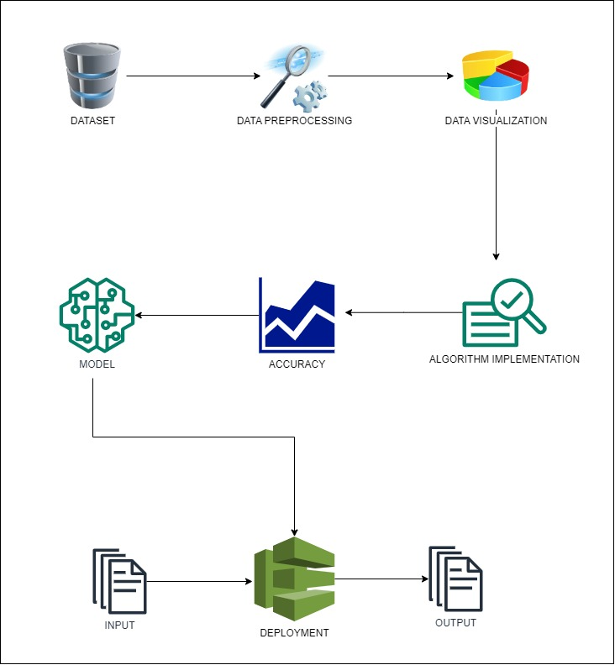
System Architecture

Slide 21
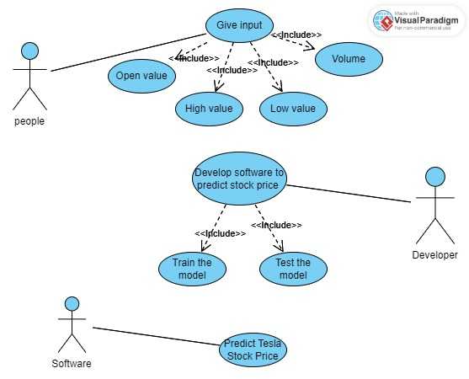
System Design – Use Case Diagram

Slide 22
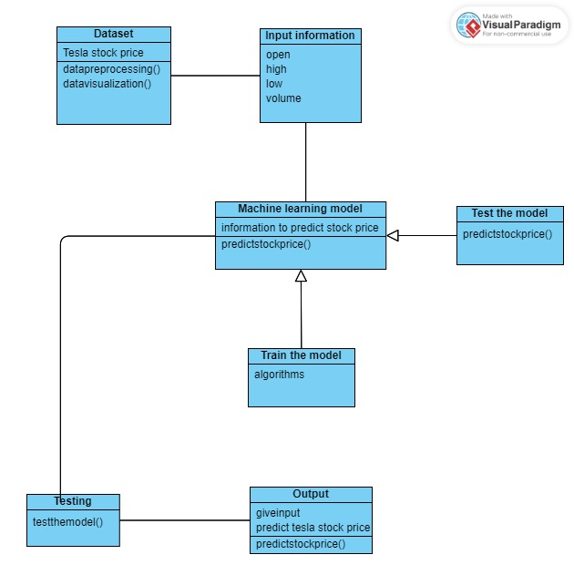
System Design – Class Diagram

Slide 23
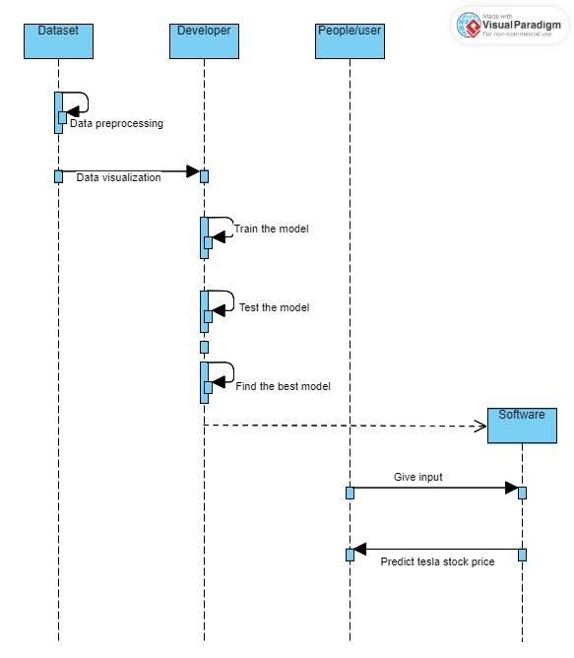
System Design – Sequence diagram

Slide 24
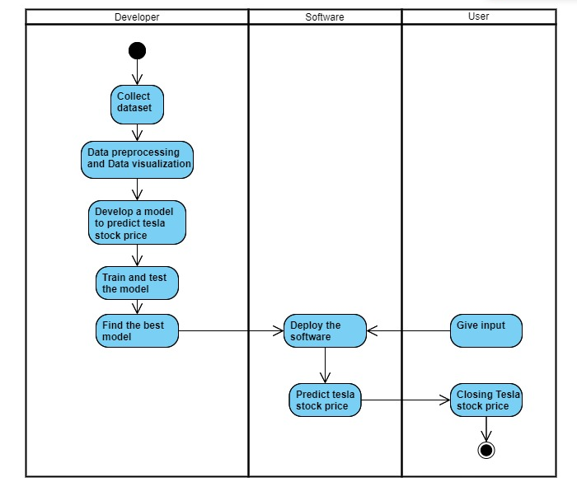
System Design – Activity diagram

Slide 25

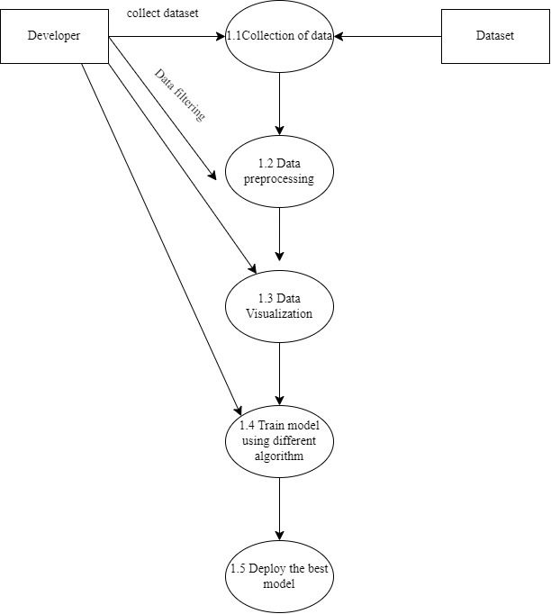
System Design – DFD diagram
Level 0
Level 1

Slide 26
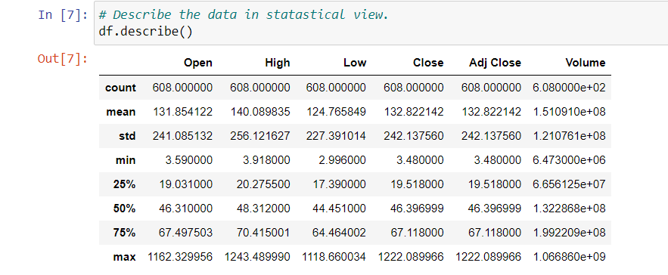
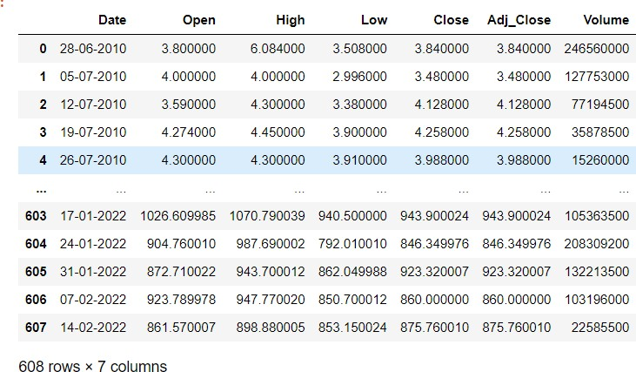
Module Description
Data Pre-processing:
Validation techniques in machine learning are used to get the error rate of the Machine Learning (ML) model, which can be considered as close to the true error rate of the dataset.
The type of missing data will influence how to deal with filling in the missing values and to detect missing values, and do some basic imputation and detailed statistical approach for dealing with missing data.
INPUT:
OUTPUT:

Slide 27
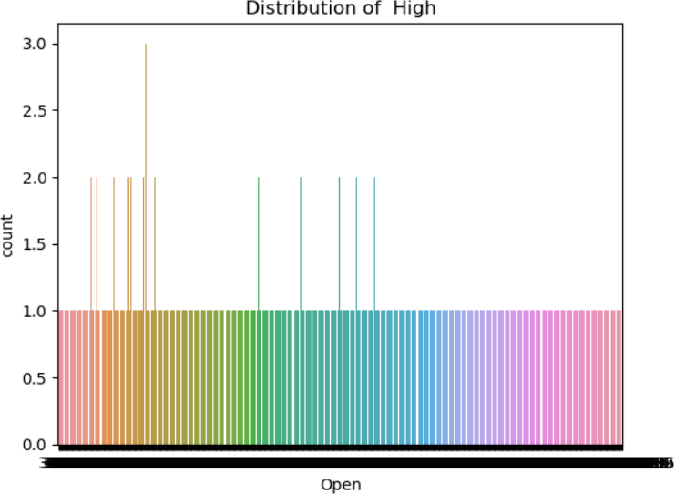
Module Description
Data Visualization:
Data visualization is a crucial ability in machine learning and applied statistics. In fact, the main focus of statistics is on numerical estimates and descriptions of data. An essential set of tools for obtaining a qualitative understanding is provided by data visualization. This can be useful for discovering trends, corrupt data, outliers, and much more while exploring and getting to know a dataset.

Slide 28
Module Description
1) ADABOOST ALGORITHM
AdaBoost is adaptive in the sense that subsequent weak learners are tweaked in favor of those instances mis-regressor by previous regressors. In some problems it can be less susceptible to the overfitting problem than other learning algorithms. The individual learners can be weak, but as long as the performance of each one is slightly better than random guessing, the final model can be proven to converge to a strong learner.
Although AdaBoost is typically used to combine weak base learners (such as decision stumps), it has been shown that it can also effectively combine strong base learners (such as deep decision trees), producing an even more accurate model.

Slide 29
Module Description
2) RIDGE ALGORITHM
Ridge regression is a regularization technique, which is used to reduce the complexity of the model. It is also called as L2 regularization. In this technique, the cost function is altered by adding the penalty term to it. The amount of bias added to the model is called Ridge Regression penalty.
Ridge works well if there are many large parameters of about the same value.
Ridge regression aims at reducing the standard error by adding some bias in the estimates of the regression.

Slide 30
Module Description
3) LASSO ALGORITHM:
Least Absolute Shrinkage and Selection Operator(LASSO) regression is a regularization technique. It is used over regression methods for a more accurate prediction. This model uses shrinkage. Shrinkage is where data values are shrunk towards a central point as the mean.
The lasso procedure encourages simple, sparse models (i.e. models with fewer parameters). This particular type of regression is well-suited for models showing high levels of multicollinearity or when you want to automate certain parts of model selection, like variable selection/parameter elimination.
Lasso Regression uses L1 regularization technique. It is used when we have more features because it automatically performs feature selection.

Slide 31
Module Description
4) DECISION TREE ALGORITHM:
Decision Tree is a Supervised learning technique that can be used for both classification and Regression problems. It is a tree-structured regressor, where internal nodes represent the features of a dataset, branches represent the decision rules and each leaf node represents the outcome.
In a Decision tree, there are two nodes, which are the Decision Node and Leaf Node. Decision nodes are used to make any decision and have multiple branches, whereas Leaf nodes are the output of those decisions and do not contain any further branches.
It is called a decision tree because, similar to a tree, it starts with the root node, which expands on further branches and constructs a tree-like structure.

Slide 32
Module Description
DEPLOYMENT
The model with high accuracy is converted to .pkl file in order to use it for webpage. Thus the best model obtained from the four algorithm is Decision Tree . This model is deployed as a webpage using Flask framework. Using this framework, we will connect the saved model of decision tree model and HTML,CSS code to create a webpage.

Slide 33
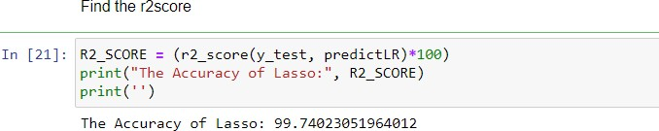
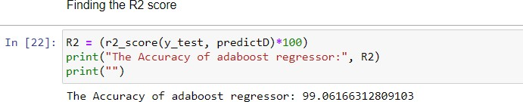
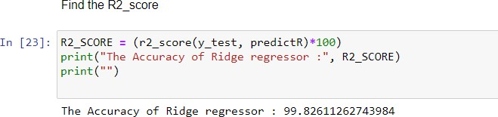
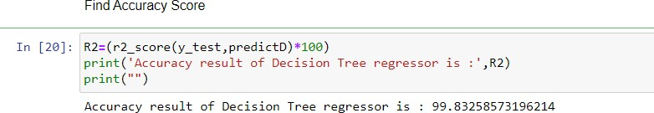
Performance Evaluation

Slide 34
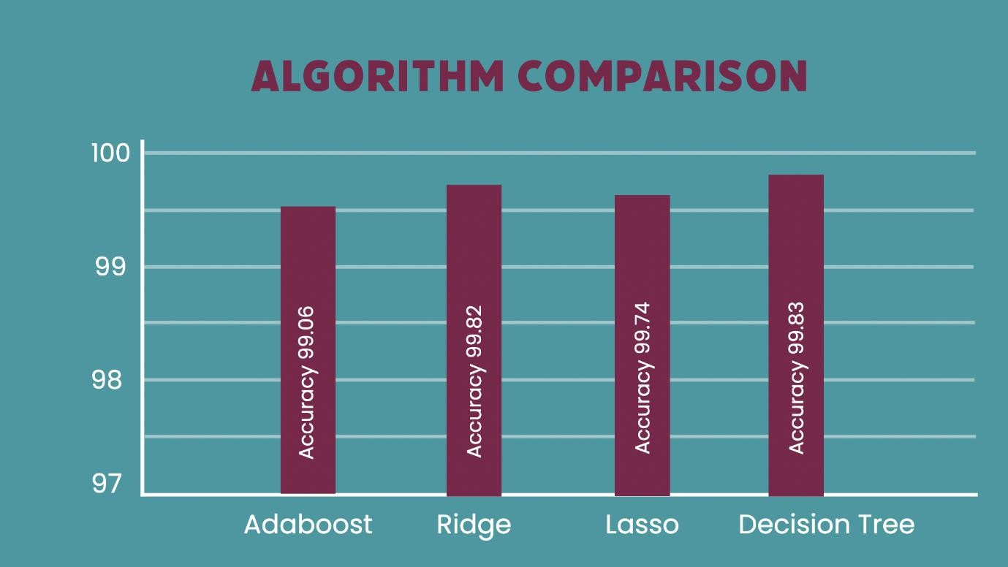
Performance Evaluation

Slide 35
Performance Evaluation
 | Mean Absolute Error | Mean Absolute Percentage Error | Explained Variance Score | Mean Squared Error | Median Absolute Error | R2 score
Adaptive boosting | 19.57 | 1.66 | 99.07 | 611.39 | 19.17 | 99.06
Ridge Regression | 4.00 | 0.04 | 99.82 | 87.95 | 0.95 | 99.82
Lasso Regression | 5.15 | 0.07 | 99.75 | 199.66 | 1.19 | 99.74
Decision Tree Regression | 4.06 | 0.04 | 99.83 | 92.38 | 1.03 | 99.83

Slide 36
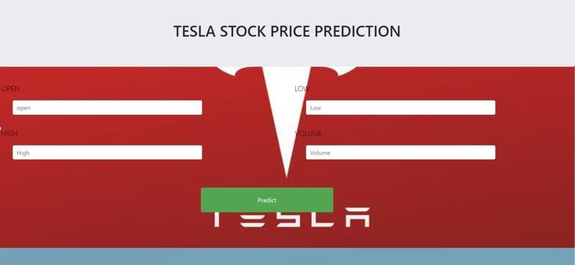
Screen Shots
Screenshot of web page for Tesla stock price prediction

Slide 37
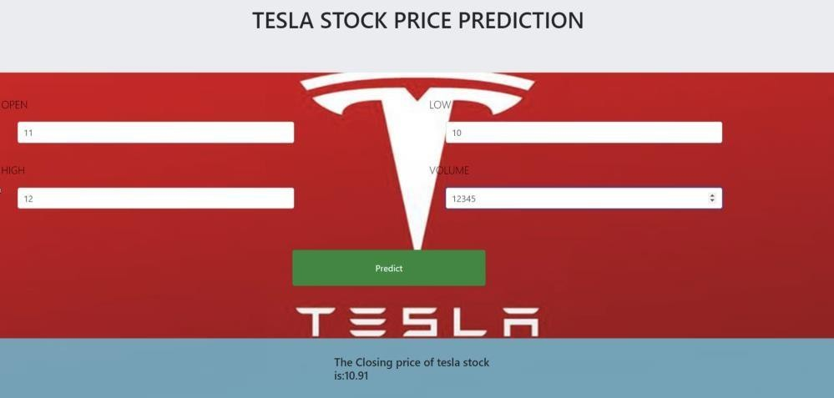
Screen Shots
Screenshot of the predicted stock price is displayed

Slide 38
Conclusion / Feature Enhancement
The analytical process started from data cleaning and processing, missing value, exploratory analysis and finally model building and evaluation. The performance of these models largely depends on the quality and size of the training data, feature engineering, and the choice of the regression algorithm. The best accuracy on public test set of higher accuracy score algorithm will be find out. The founded one is used in the application which can help to find the tesla stock price. Deploying the project in the cloud. To optimize the work to implement in the IOT system. In future ,we can extend this application for predicting crypto currency trading . It would be a useful alteration to include more than just one stock in the analysis. This would make prediction more challenging, but, at the same time, there are likely to be correlations between different companies that may be learned by the model architecture.

Slide 39
Reference Paper/ URL
G. Li, A. Zhang, Q. Zhang, D. Wu and C. Zhan, "Pearson Correlation Coefficient-Based Performance Enhancement of Broad Learning System for Stock Price Prediction," in IEEE Transactions on Circuits and Systems II: Express Briefs, vol. 69, no. 5, pp. 2413-2417, May 2022, doi: 10.1109/TCSII.2022.3160266.
Zaznov, I.; Kunkel, J.; Dufour, A.; Badii, A. Predicting Stock Price Changes Based on the Limit Order Book: A Survey. Mathematics 2022, 10, 1234. https://doi.org/10.3390/math10081234
Dylan M. Crain, Stock Movement Prediction using Technical and Data, Stanford Department of Energy Resources Engineering 736 Serra St., Stanford CA, 94305
N. Naik and B. R. Mohan, "Novel Stock Crisis Prediction Technique—A Study on Indian Stock Market," in IEEE Access, vol. 9, pp. 86230-86242, 2021, doi: 10.1109/ACCESS.2021.3088999.
P. Srivastava and P. K. Mishra, "Stock Market Prediction Using RNN LSTM," 2021 2nd Global Conference for Advancement in Technology (GCAT), Bangalore, India, 2021, pp. 1-5, doi: 10.1109/GCAT52182.2021.9587540.

Slide 40
Reference Paper/ URL
M. Nabipour, P. Nayyeri, H. Jabani, S. S. and A. Mosavi, "Predicting Stock Market Trends Using Machine Learning and Deep Learning Algorithms Via Continuous and Binary Data; a Comparative Analysis,“
I. Bhattacharjee and P. Bhattacharja, "Stock Price Prediction: A Comparative Study between Traditional Statistical Approach and Machine Learning Approach," 2019 4th International Conference on Electrical Information and Communication Technology (EICT), Khulna, Bangladesh, 2019, pp. 1-6, doi: 10.1109/EICT48899.2019.9068850.
Selvamuthu, D., Kumar, V. & Mishra, A. Indian stock market prediction using artificial neural networks on tick data. FinancInnov 5, 16 (2019).doi: https://doi.org/10.1186/s40854-019-0131-7
A, Yashmita & D, Dr. (2023). Building a Stock Price Prediction Model using Random Forest Regression and Sentimental Analysis. INTERANTIONAL JOURNAL OF SCIENTIFIC RESEARCH IN ENGINEERING AND MANAGEMENT. 07. 10.55041/IJSREM18258.
S. Sarode, H. G. Tolani, P. Kak and C. S. Lifna, "Stock Price Prediction Using Machine Learning Techniques," 2019 International Conference on Intelligent Sustainable Systems (ICISS), Palladam, India, 2019, pp. 177-181, doi: 10.1109/ISS1.2019.8907958.

